Slide 1
Turing Machines

Slide 2

A malteser Game
You should have a row of Honey and Dark malteser Maltesers….

Slide 3
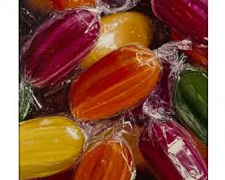
A malteser Game
You should have a row of Honey and Dark malteser Maltesers….
And 6 different coloured sherbets

Slide 4
A malteser Game
A row of honey and dark Maltesers
Start with a red sherbet

Slide 5
A malteser Game
Please take a note of the arrangement of maltesers on the table…
Take a photo (or a selfie with it) if you like!

Slide 6



SHERBERT | MALTESER | INSTRUCTION
RED | HONEY | The new malteser is HONEY, the new sherbert is RED and you move
RED | DARK | The new malteser is DARK, the new sherbert is ORANGE and you move
ORANGE | HONEY | The new malteser is HONEY, the new sherbert is YELLOW and you move
ORANGE | DARK | The new malteser is DARK, the new sherbert is ORANGE and you move
YELLOW | HONEY | The new malteser is HONEY, the new sherbert is YELLOW and you move
YELLOW | DARK | The new malteser is HONEY, the new sherbert is GREEN and you move
GREEN | HONEY | The new malteser is HONEY, the new sherbert is VIOLET and you move
GREEN | DARK | The new malteser is DARK, the new sherbert is BLUE and you move
BLUE | HONEY | The new malteser is HONEY, the new sherbert is BLUE and you move
BLUE | DARK | The new malteser is HONEY, the new sherbert is YELLOW and you move
VIOLET | HONEY | The new malteser is HONEY, the new sherbert is VIOLET and you move
VIOLET | DARK | The new malteser is HONEY, the new sherbert is NONE and you

Slide 7
A malteser Game
What do you notice about the final arrangement of maltesers?
What has happened?

Slide 8
A malteser Game
We’ve just represented a whole computer!

Slide 9
A malteser Game
We’ve just represented a whole computer!
The computer is the combination of the table, maltesers and sherberts.
The rules are its program
The table of maltesers is the memory
The sherberts are the ‘control state’.

Slide 10
A malteser Game
We’ve just represented a whole computer!
The computer is the combination of the table, maltesers and sherberts.
The rules are its program
The table of maltesers is the memory
The sherberts are the ‘control state’.
When you follow the rules and eat the maltesers, you are executing the program.

Slide 11
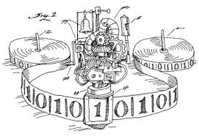
Turing Machines
A turing machine is a simple form of a computer that reads and manipulates a string of symbols according to a predefined set of rules.
It consists of a Reader, a Writer and a Tape.

Slide 12
Reading Turing Machine Instructions
Current State | Read | Write | Move | New State
1 | 1 |  | R | 1
1 | # | 1 |  | 2
2 | 1 |  | R | 2
2 | # |  | L | 3
3 | 1 | # |  | 3
3 | # |  | L | 4
4 | 1 |  | L | 4
4 | # |  | R | HALT

Slide 13
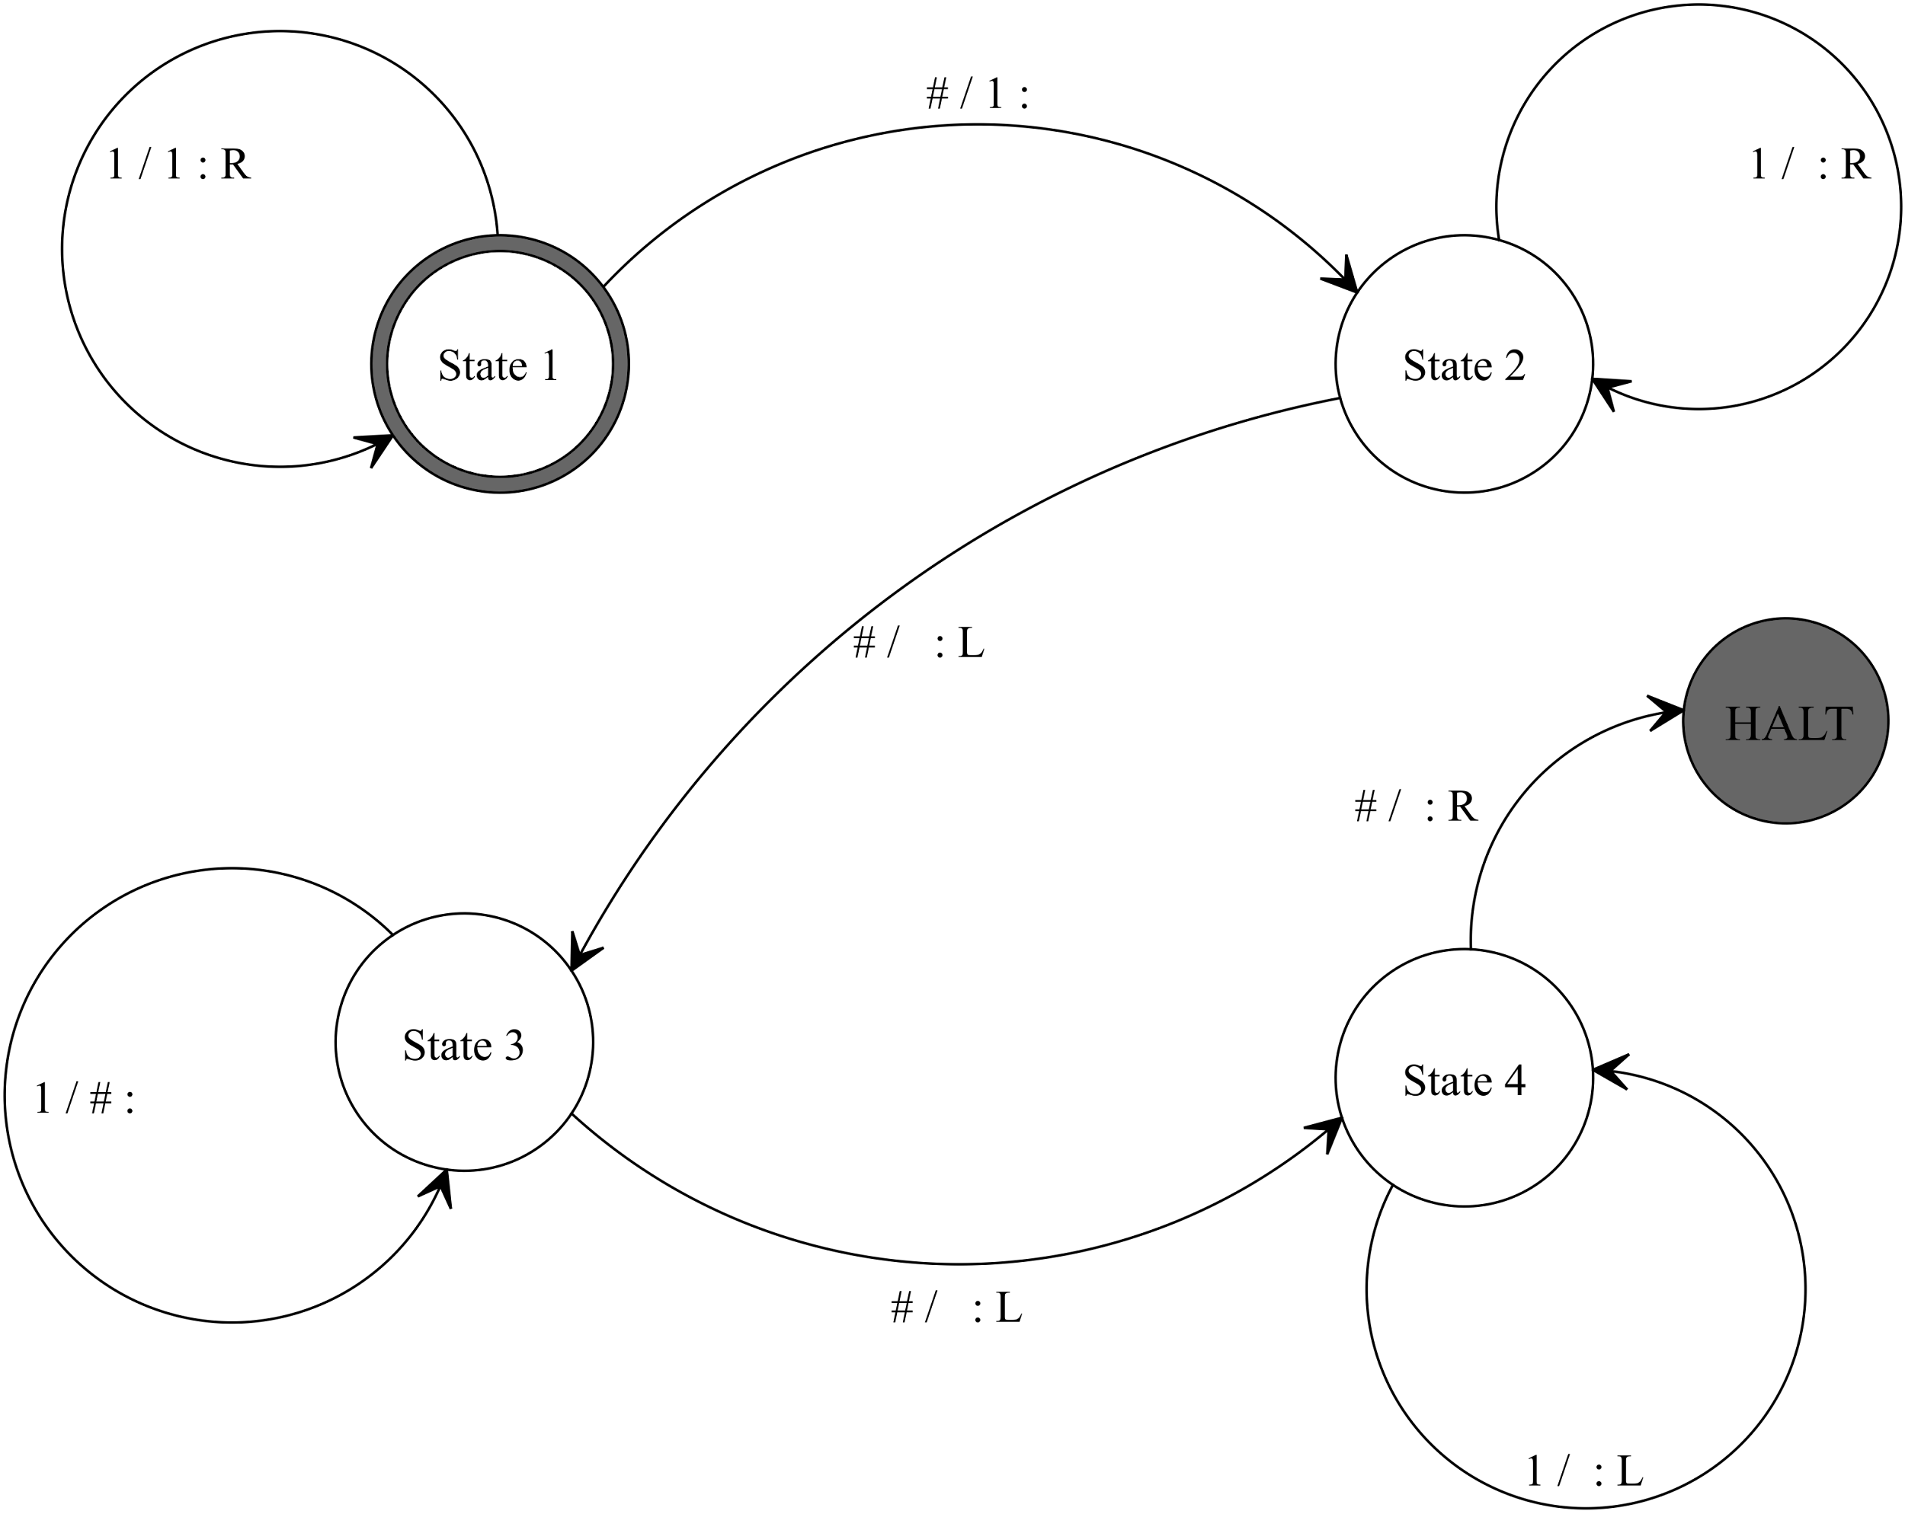

Slide 14
Start here
# | # | 1 | 1 | 1 | 1 | 1 | 1 | 1 | #

